Slide 1
BIOL 347: Microbiology
Exploring The Geographic Information Systems (GIS) Applications for Health Science
Dr. Maruthi Sridhar B. Bhaskar
Department of Environmental and Interdisciplinary Sciences
Texas Southern University

Slide 2
1) In this exercise, you will be importing the Chlamydia incidence data of Texas for Year 2014, from excel file into the GIS and then create a shape file from the data.
2) You will be joining the table with the spatial data and importing the attributes into the spatial database.
3) You will create spatial maps showing Chlamydia incidence in Texas

Slide 3

To open the ArcGIS software, click on the ‘start’ program and then select ‘ArcGIS’ and then ‘ArcMap’

Slide 4
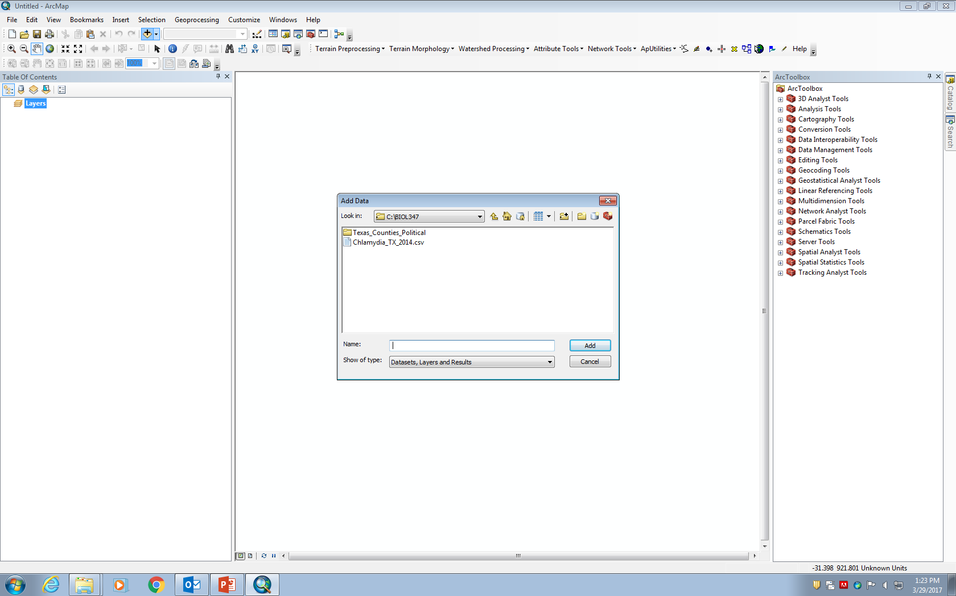
Now you can see the window of ArcMap software. Now click on the ‘+’ sign located on the second row of Menu and then a pop up window “Add Data” will come up.

Slide 5
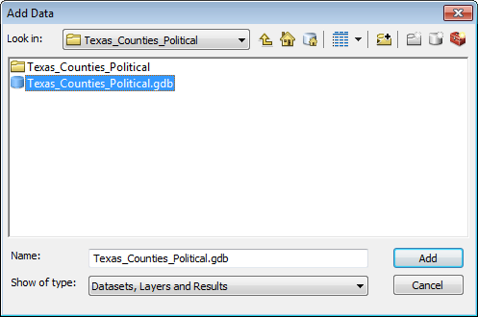
In the ‘Add Data’ window, select the “Texas_Counties_Political.gdb” and then click Add.

Slide 6
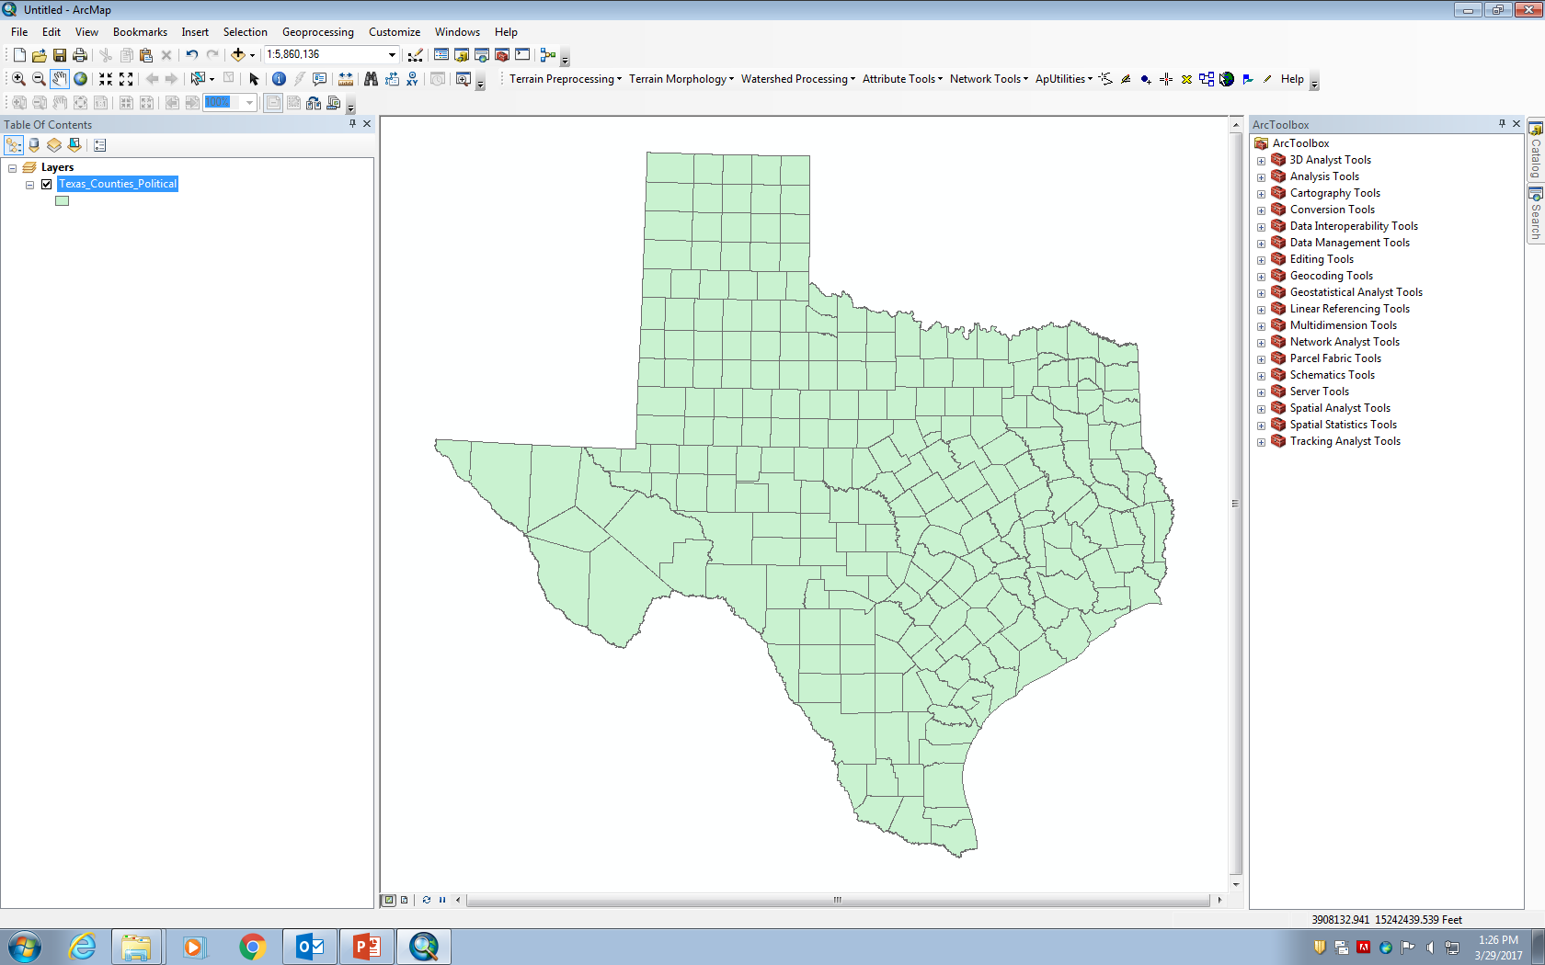
Now you can see a map of Texas State with all the counties displayed.

Slide 7
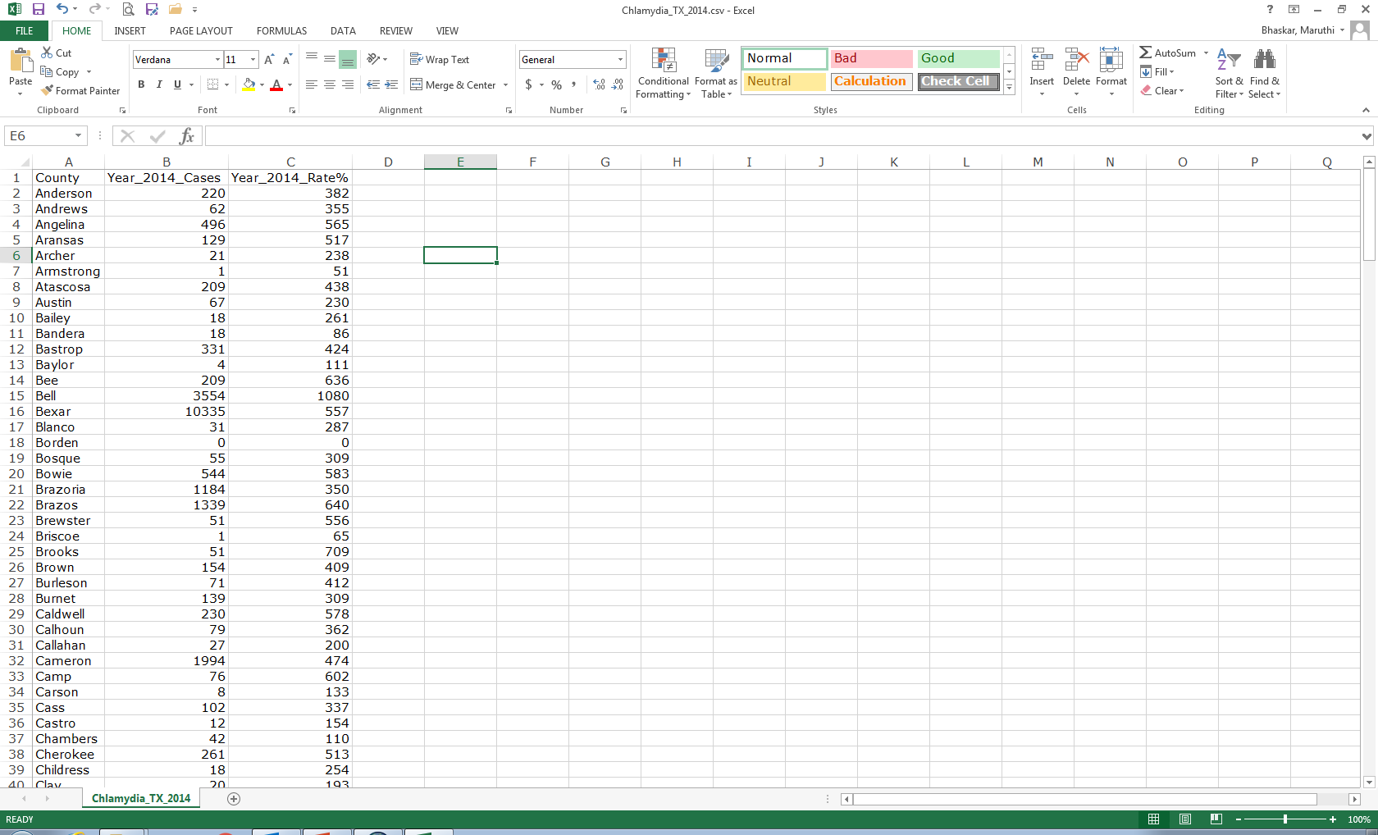
Open the excel file “Chlamydia_TX_2014.CSV” located in the C:\\BIOL347 folder and it will show the disease cases and rate arranged county wise in alphabetical order.

Slide 8
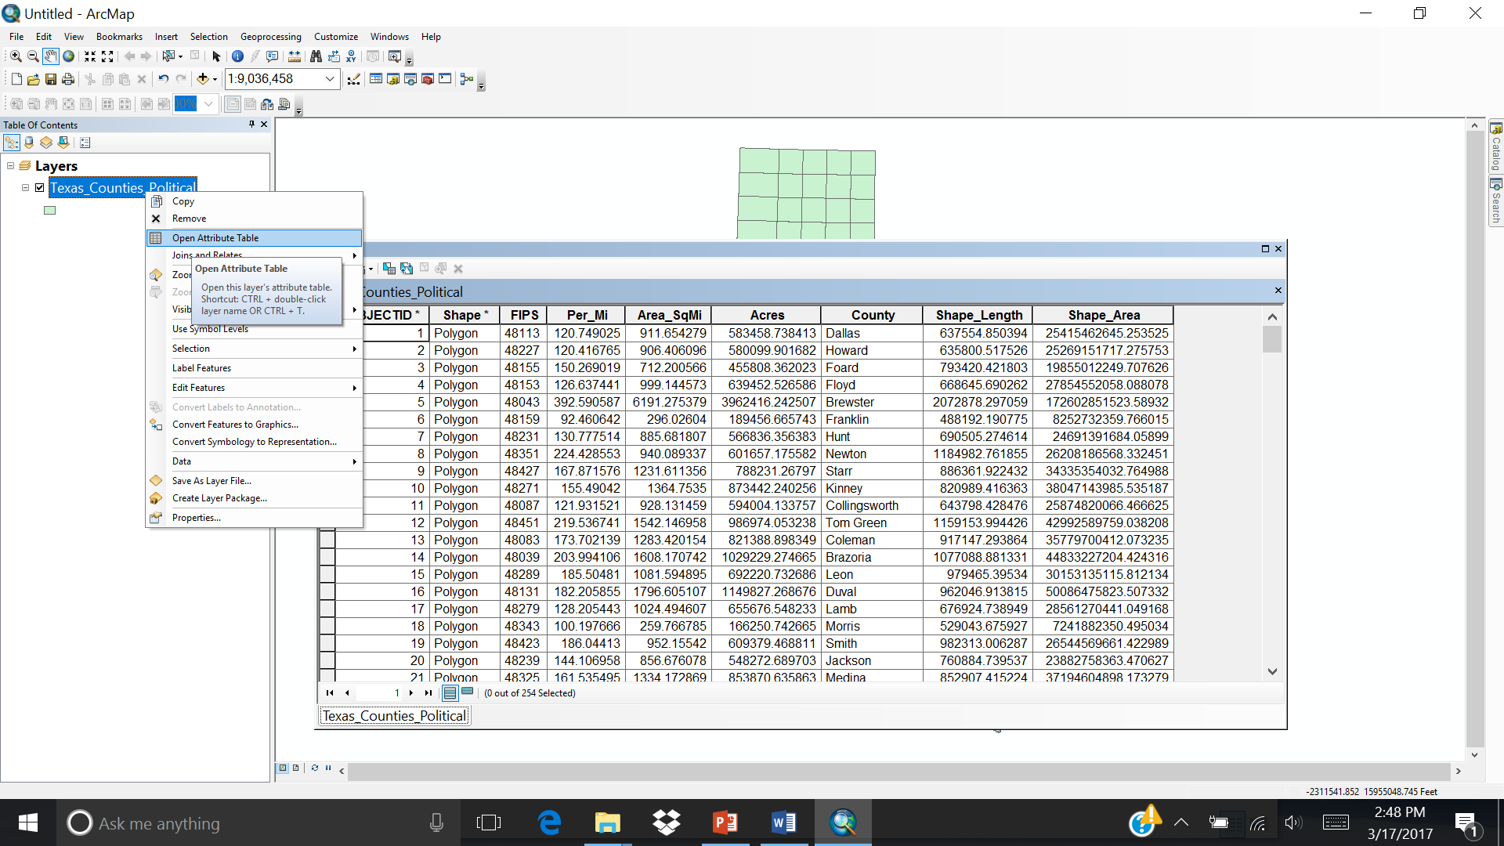
Open the attribute table of the shape file and compare with the ‘Chlamydia_TX_Cases_2014’ data file. The “common key” in both the databases is the “County”.

Slide 9
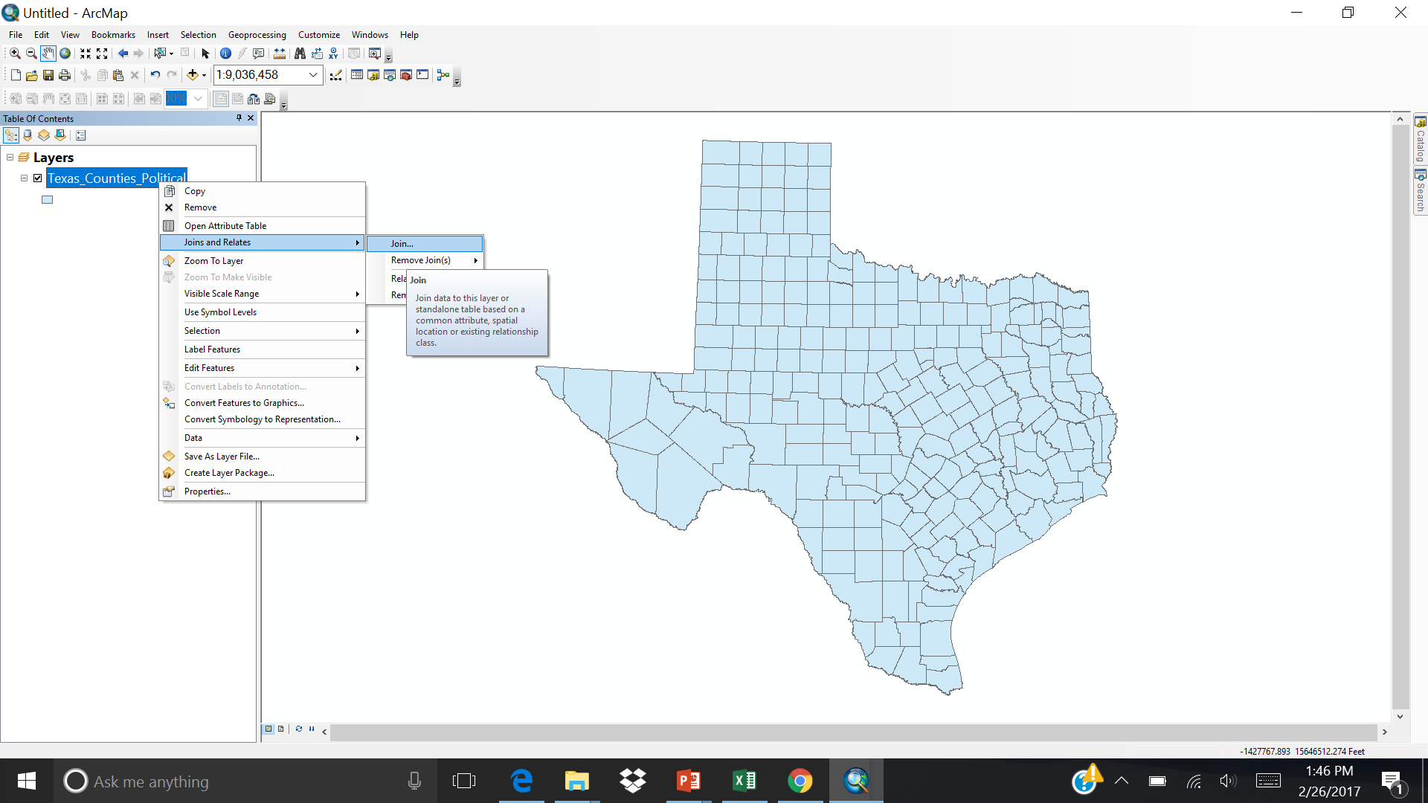
As the ‘Chlamydia_TX_2014’ data file do not have any x,y coordinates, we need to ‘join’ the data using the common key in the attribute table of Texas Counties. Right click on the “Texas_Counties_Political” and then select “Join and Relates” and then Join.

Slide 10
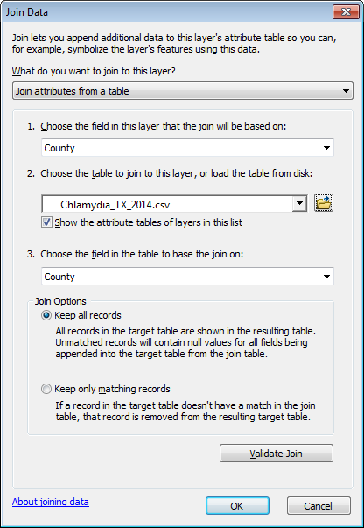
In the pop up window in the first row select ‘county’ and in the second row navigate to the “Chlamydia_TX_ Cases_2014” excel data and then select that file and in the third row again select ‘county’. Then click “Validate Join” and then ok.

Slide 11
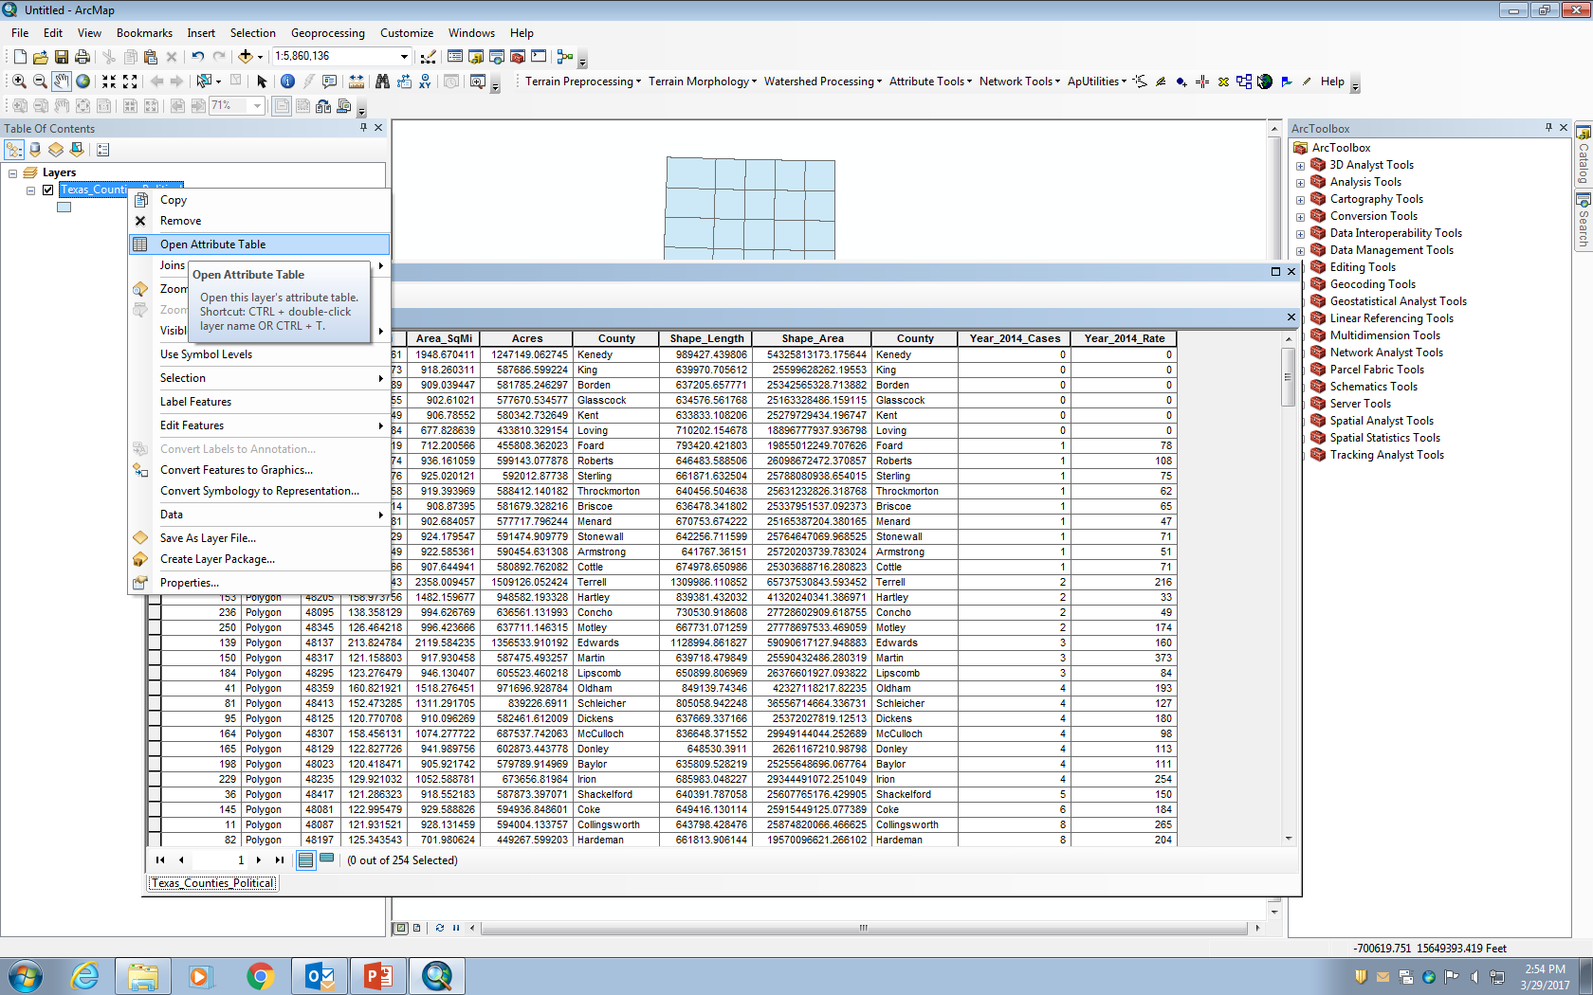
Then right click and open the attribute data of ‘Texas_Counties_Political’. You can see the data from the Chlamydia_TX_ 2014 excel file is appended at the end of the table. Now you can do analysis on the data.

Slide 12
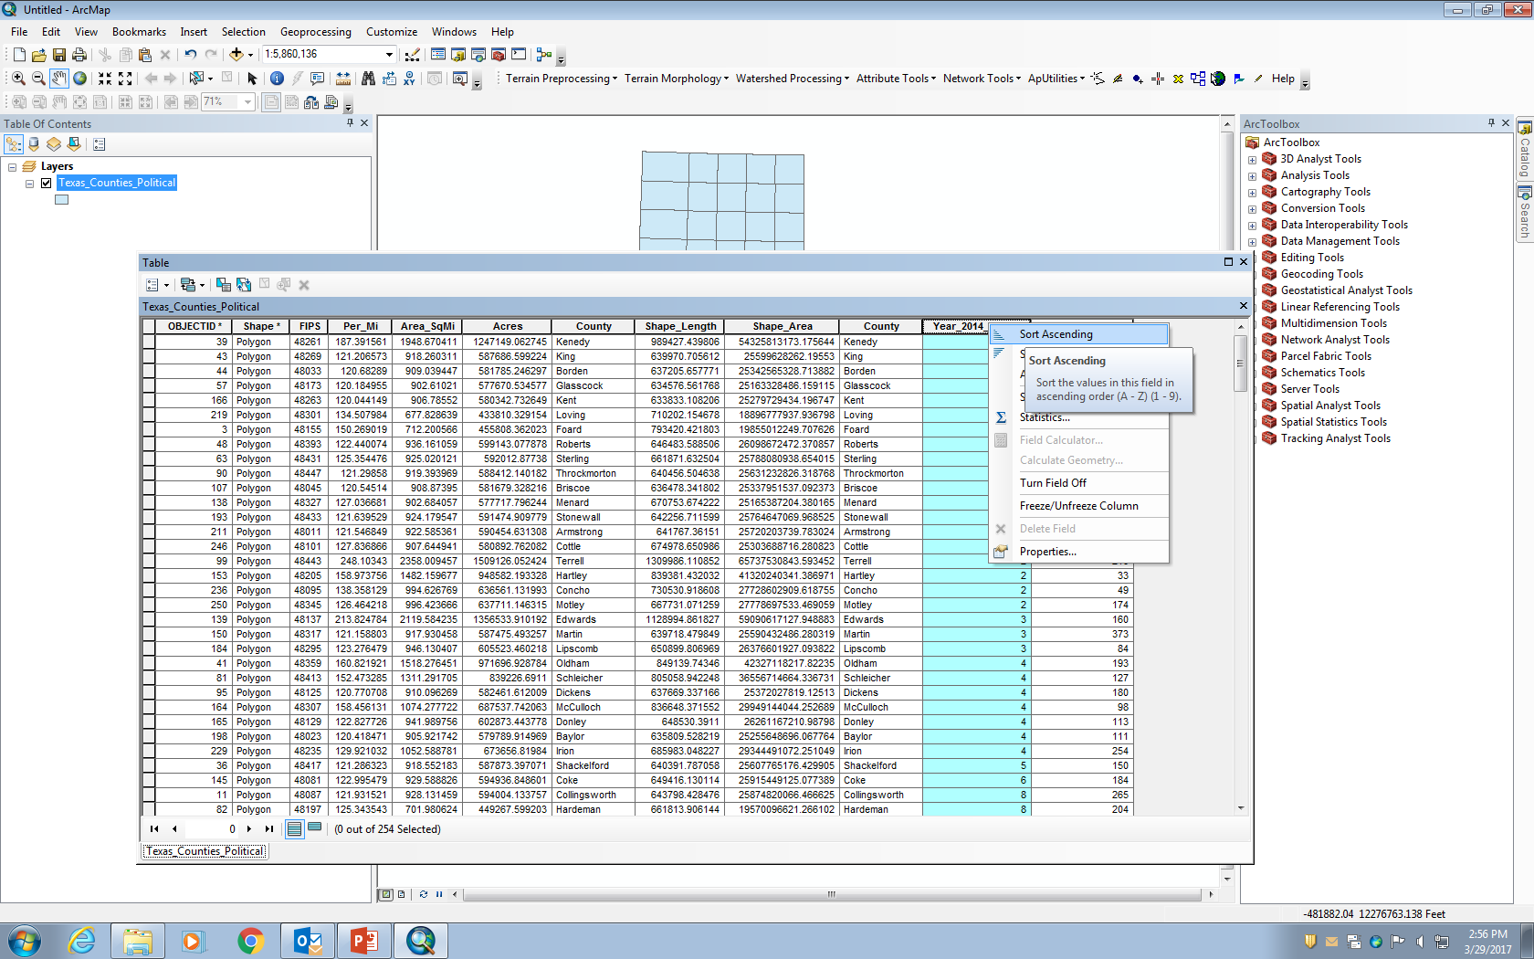
Select the column ‘Year_2014_Cases’ and then right click and select ‘Sort Ascending’ in the popup menu. To get the county with lowest and highest number of Chlamydia cases.

Slide 13
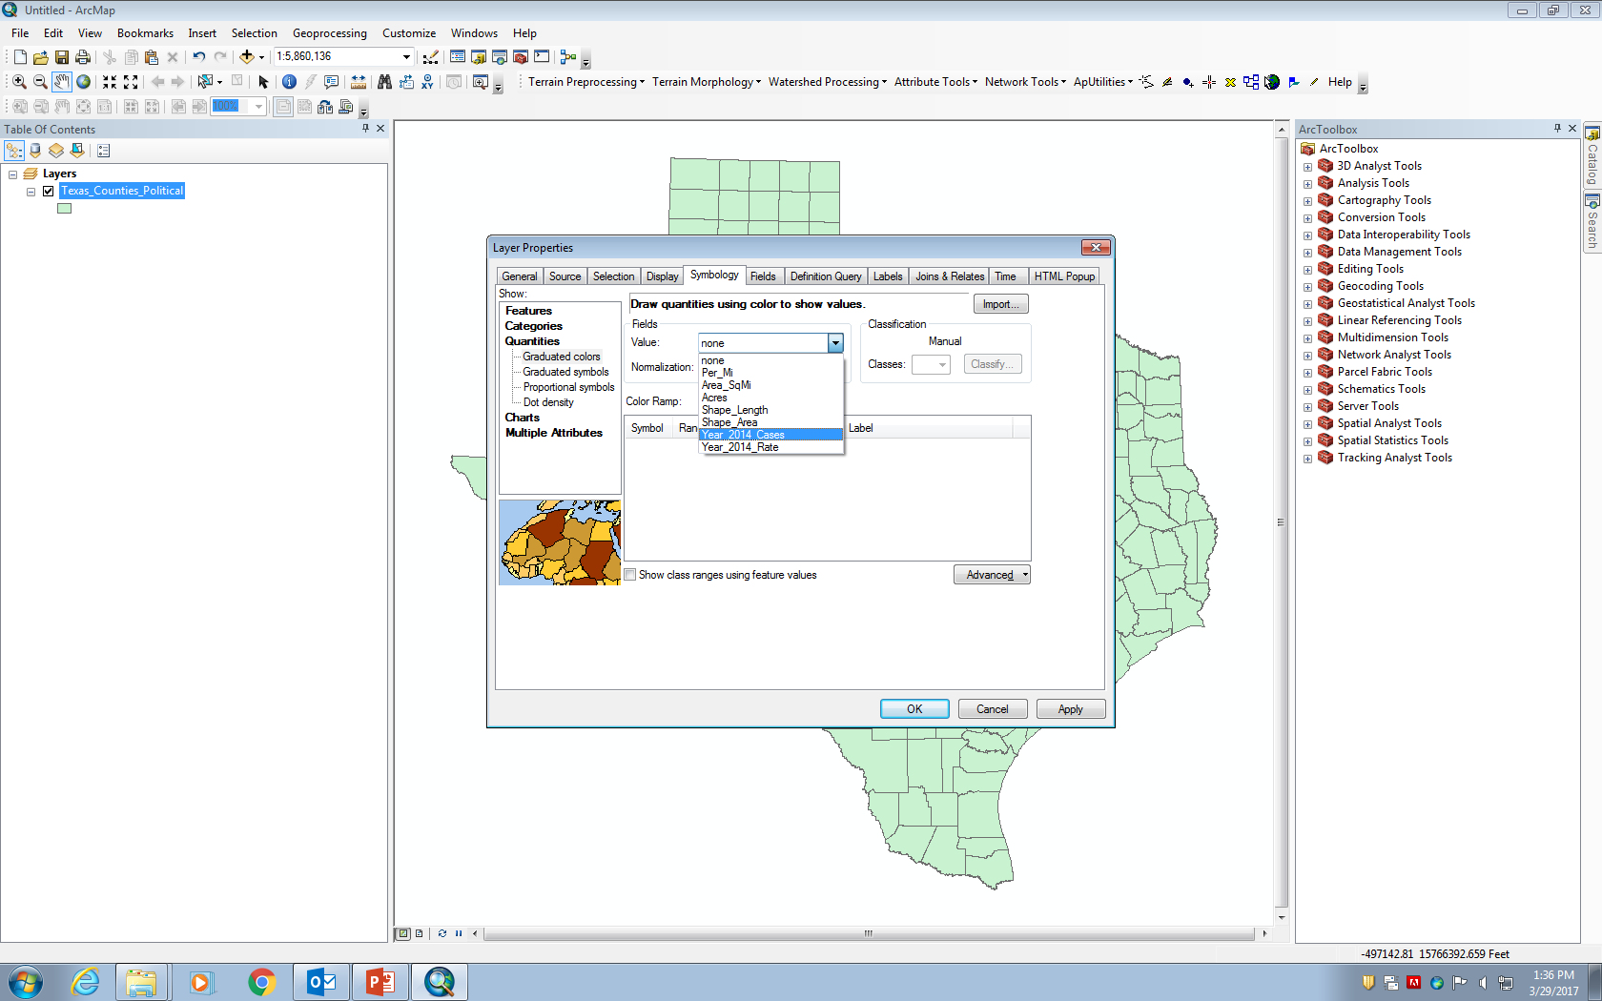
Now double click on the “Texas_Counties_Political” and then in the pop up window of layer properties select “quantities” and then select “Year_2014_Cases” in the value field and then click ok.

Slide 14
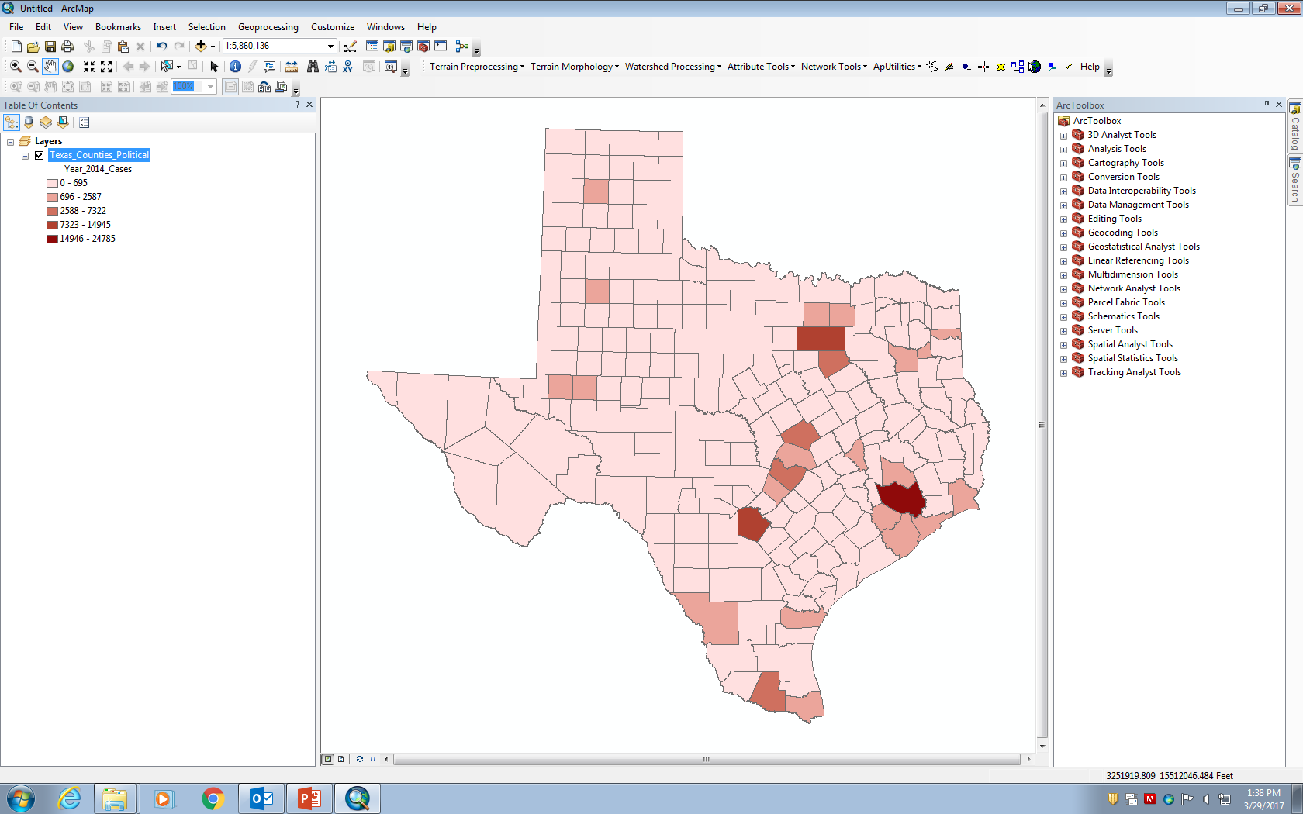
Now you can see the counties colored and classified based on the number of Chlamydia incidence cases in each county. You can then click ‘view’ and ‘layout view’, so that we can make a professional map of the image.

Slide 15
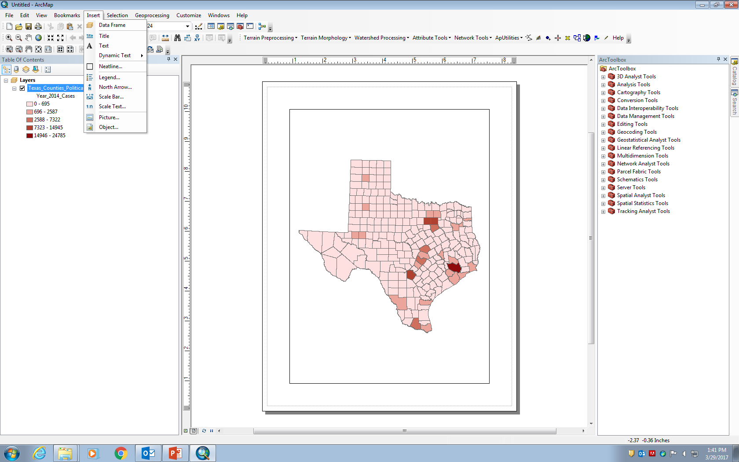
Once you open the map in the layout view. You will see the image placed on a scale and then you can resize the image using the magnifying glass icon. Then click “Insert” and then add ‘title’, ‘legend’, ‘north arrow’ and ‘scale bar’ by selecting each one.

Slide 16

Once your map is made like the way you want. Then click “Edit” and “Copy Map to Clipboard” and then navigate to the blank power point slide and paste it.

Slide 17
Now you can show the GIS image of the Chlamydia incidence profile of Texas for all the counties.

Slide 18
Following the same steps that you used earlier, use the “Chlamidia_TX_Rate_ 2014” data to create a map of the Rate of incidence. Chlamydia incidence rate is defined as the number of chlamydia cases per 100,000 people.

